Slide 2

Audit of Food Units and Hoffman Invoice: Will County
Comparative Analysis of Reported vs. Billed Units for July 2025
Corey Gustafik MSND King’s College
August 29th, 2025

Slide 3
Executive Summary
Evaluate alignment between CNNSSA’s reported meal units (23,927 total) and Hoffman House catering invoiced at ($118,913.94 total w/ 21,809 units for July 2025)
Key Findings:
  Net Discrepancy: 2,118 units under billed (8.85% of units) ~$16,148 not being billed.
  Variations by site: Under Billing is major concern (but cause could be from non-catered items)
  Explanations: timing errors, vendor exclusions (e.g., emergency/ shelf stable), pricing variations and recording inconsistencies.
Implications: Should implement more standardized protocols for units and billing.

Slide 4
Methodology and Data Source
Approach:
  Unit calculations: single meal (e.g., regular, vegetarian etc.) =1 unit; MISC bundles (e.g., frozen 5-packs)=5 units; non meal (e.g., milk/juice) excluded.
  Comparison: site-level reported units (from CNNSSA summary; congregate HDM-hot/frozen/shelf-stable) vs invoiced billed units.
Analysis: Quantitative differences plus qualitative observations..
Data sources: CNNSSA July 2025 unit summary; Hoffman House invoice via Charmaine.
Limitations: Potential errors in totals; assumes all non-invoiced meals are from alternative vendors.

Slide 5
Summary table
Site (Unit Summary Name) | Invoice Code | Invoice Cost ($) | Billed Units (Calculated) | Reported Units (Summary) | Difference (Reported - Billed) | Notes on Discrepancy
Joseph & Sara Levy Center | 800 | 25,800.07 | 4,512 | 5,195 | 683 | Significant under-billing
Lockport Township | 810 | 9,178.57 | 1,609 | 1,631 | 22 | Minor under-billing
Guy Sell Sr. Housing | 820 | 3,907.65 | 687 | 679 | -8 | Minor over-billing
Frankfort Township Bldg. | 830 + 830 SUB | 11,742.22 | 2,032 | 1,892 | -140 | Over-billing: SUB may include a special event
New Hope Christian Community | 840 | 15,862.38 | 2,778 | 3,01 | 236 | Under-billing
Troy Township | 860 | 330 | 60 | 332 | 272 | Significant under-billing
Park Tower | 870 + 870 SUB | 2,381.66 | 418 | 374 | -44 | Over-billing
Central Nutrition Site | 880 | 27,030.00 | 5,737 | 5,682 | -55 | Minor over-billing
Joshua Arms | 890 | 14,053.58 | 2,465 | 3,007 | 542 | Significant under-billing
Wilmington Lions Hall | 895 | 8,627.81 | 1,511 | 1,831 | 320 | Under-billing
Totals (Invoiced Sites) | - | 118,913.94 | 21,809 | 23,637* | 1,828 | Net under-billing;

Slide 6
Site Analysis per site
Joseph & Sara Levy Center
  Invoice: $25,800.07; billed 4,512; reported 5,195; difference +683 Under-billed
Lockport Township
  Invoice: $9,178.57; billed 1,609; reported;1,631;difference +22 under-billed
Guy Sell Sr. Housing
  Invoice:$3,907.65; billed 687; reported;679; difference -8 over-billed
Frankfort Township Bldg.
  Invoice: $11,742.22; billed 2,302; reported 1,892; difference -140 over-billed
New Hope Christian Community
  Invoice: $15,862.38; billed 2,778; reported 3,014; difference +236 under-billed

Slide 7
Site Analysis per site cont.
Troy Township
  Invoice: $330.00; billed 60; reported 332; difference +272 under-billed
Park Tower
  Invoice: $2,381.66; billed 418; reported; 374; differences -44 over-billed
Central Nutrition Site
  Invoice: $27,030.00; billed 5,737; reported 5,682; difference -55 over-billed
Joshua Arms
  Invoice: $14,053.58; billed 2,465; reported 2,465; differences +542 under billed
Wilmington
  Invoice: $8,627.81; billed 1,511; reported 1,831; differences +320

Slide 8
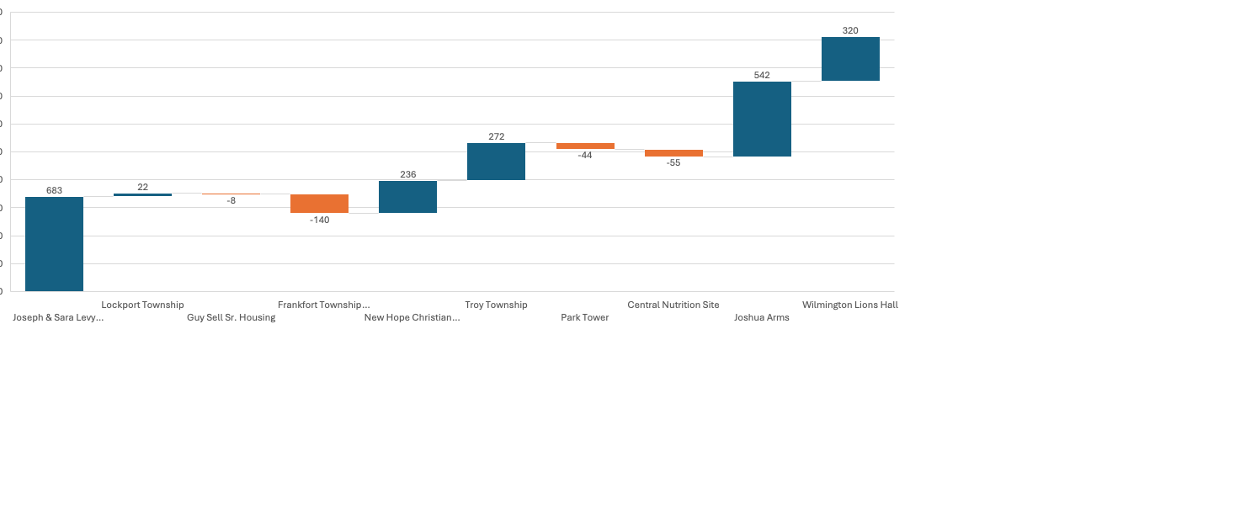
Discrepancy Visualization Across sites

Slide 9
Conclusions
Overall: Reported 23,927 vs billed 21,809; net under-billing of 2,118 (13.03%) equals ~12,093-16,148 unbilled units
Site Rankings
  Best: guy sell Sr. housing (8 units over-billed)
  Worst: Joseph & Sara Levy Center (683 under-billed)
  Middle: Frankfort (140 over-billed), New Hope (236 under-billed)
Root Cause: Different vendors, timing errors, bundling variations, special events.

Slide 10
Recommendations
Short Term: Cross-verify invoices with reports monthly; standardized unit definitions
Long Term: Integrate all vendors orders for real time tracking
Policy: Implement protocols to track all leftover meals and stored meals
Next Steps: Pilot software to integrate all vendors into one system.

Slide 11
Q & A
Please address any questions at this time

