Slide 1
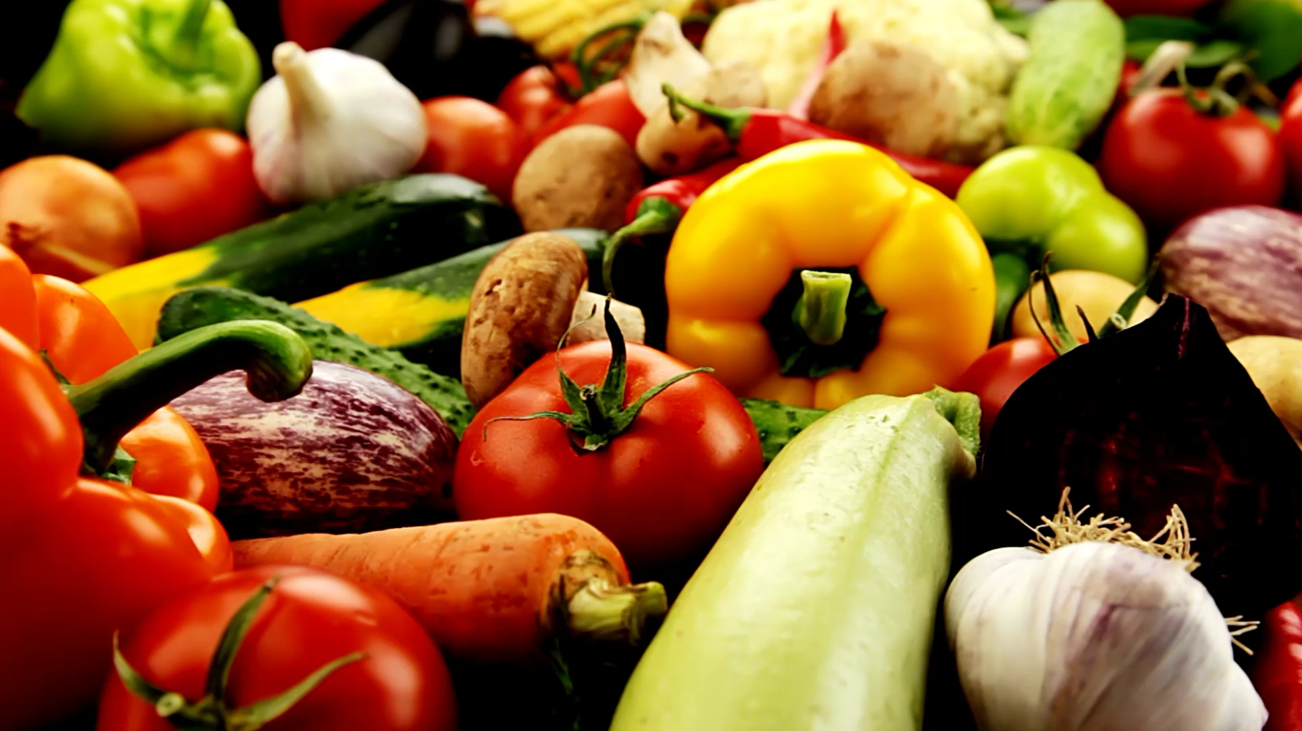
Protecting our seniors: food Safety in Meals on Wheels
Ensuring Safe Meal Deliveries
Corey Gustafik, MSND Kings College
May, 14, 2025

Slide 2
Why Food Safety Matters
Seniors (65+) are at high risk for foodborne illnesses due to weakened immune systems
Severe outcomes: hospitalization, dehydration and death
Reputation: Safe meals build trust in our program and clients

Slide 3
Top pathogens That Threaten Seniors
Pathogen | Symptoms | Foods | Prevention
Listeria | Fever, stiff neck, confusion, and convulsions | Soft cheeses, deli meats and spreads | Avoid unpasteurized dairy, proper storage (<40F), and reheat foods to 165F
Salmonella | Diarrhea, fever, cramps and last 4-7 days | Chicken, raw fruits/ veggies and cross contamination | Cook chicken to 165F and wash produce thoroughly and avoid cross contamination
E. Coli | Severe bloody diarrhea, stomach pain and HUS lasting 5-10 days. | Uncooked beef, cross-contamination and raw fruits and veggies | Cook foods to safe temperatures, wash produce and avoid cross-contamination.
Norovirus | Vomiting and diarrhea for 1-3 days but up to 6 for seniors | Salads, fruits, and ready to eat foods touched by infected handlers | Handwashing, disinfect surfaces and exclude sick staff
Botulism | Double vision, muscle weakness and can be fatal | Improper canning, oils and sauces | Use commercially canned products and store foods properly

Slide 4
Other pathogens to Monitor
Bacillus Cereus: Rice, leftovers; causes diarrhea/ vomiting (24hrs)
Clostridium Perfringens: Beef, poultry, gravies; diarrhea (1-2 weeks in severe cases)
Campylobacter: raw milk, poultry; diarrhea, fever (1 week)
Staphylococcus Aureus: contaminated handled foods; vomiting (1 day)
Hepatitis A, Shigella, Vibrio: less common and preventable with good hygiene

Slide 5
Bacillus Cereus
Sources | Rice and leftovers and sauces, soups and other food left at room temp.
Incubation Period | Diarrhea-6-15 hrs. Vomiting-30 minutes to 6hrs
Symptoms | Diarrhea Cramps Nausea and vomiting
Duration | 24 hrs.
What to do | Drink fluids and get rest
Prevention | Store in 40F or under in less than 2 hrs

Slide 6
Botulism
Sources | Infants-honey All ages- improper stored canned or preserved foods
Incubation period | Infants-3-30days Children and adults-18-36hrs.
Symptoms | Infant-lethargy, poor feeding, constipation Children and adults-double vision, blurred vision, drooping eyelids, difficulty swallowing, dry mouth and muscle weakness
Duration | Variable
What to do | This is a medical emergency and if symptoms appear seek medical attention
Prevention | Follow safe canning instruction Don’t feed honey to infants Buy commercial canned and preserved products

Slide 7
Campylobacter
Sources | Unpasteurized dairy, Poultry, shellfish, water
Incubation Period | 2 to 5 days
Symptoms | Diarrhea, cramps, fever, vomiting
Duration | About one week
What to do | Drink plenty fluids, seek medical attentions
Prevention | Drink pasteurized milk, drink treated water

Slide 8
Clostridium Perfringens
Sources | Beef, poultry, gravies, food left out at room temp
Incubation Period | 6 to 24 hrs.
Symptoms | Diarrhea and stomach cramps
Duration of illness | Less than 24 hrs. in severe cases up to 2 weeks
What to do | Drink plenty of fluids and seek medical attention
Prevention | Cook food thoroughly to 165F Use thermometer to test temp Keep foods at 140F or store in fridge

Slide 9
E. coli
Sources | Contaminated food (beef, unpasteurized dairy, raw fruits/ veggies) Contaminated water
Incubation Period | 3 to 4 days for most but can be 1-10 days
Symptoms | Severe diarrhea (bloody), stomach pain, vomiting and small fever, dehydration
Duration of illness | 5 to 10 days and most people will be better in 5-7 days
What to do | Drink fluids and get rest and seek medical attention
Prevention | Avoid high risk foods, cook to 165F, wash hands while handling foods

Slide 10
Hepatitis A
Sources | Raw and undercooked shellfish from contaminated water, raw produce, drinking water and contact from infected people
Incubation Period | 28 days average range (15-50 days)
Symptoms | Diarrhea, dark urine or light stool, jaundice, fatigue, fever, joint pain, stomach pain, loss of appetite
Duration of Illness | Last around 2 months but can be up to 6 months
What to do | See doctor if signs and symptoms are present
Prevention | Avoid eating raw oysters or other raw shellfish Wash hands with soap for 20 seconds Vaccinate for Hep A

Slide 11
Listeria
Sources | Unpasteurized dairy, raw fruits/Veggies, RTE and deli meats, pates, smoked meats
Incubation Period | 1-4 weeks but can be up to 70 days
Symptoms | Fever, diarrhea But if beyond gut can be stiff neck, confusion, loss of balance, convulsions For pregnant women- fever, fatigue and muscle aches
Duration of illness | Days to weeks
Who is at risk | Adults 65 and older Pregnant women Immune co promised
What to do | For invasive, antibiotics are needed for everyone
Prevention | Recommendations for everyone: No raw diary, wash raw fruits and veggies Recommendations for high risk: Do not eat: pates, processed meats not cooked to 165, raw or lightly cooked sprouts,

Slide 12
Norovirus
Sources | Produce, shellfish and RTE touched by infected people
Incubation period | 12-48 hrs.
Symptoms | Diarrhea, vomiting, nausea, stomach pain
Duration of illness | 1 to 3 days but young children and older adults are more vulnerable (last 4-6 days)
What to do | Drink plenty of water and get rest and seek medical attention
Prevention | Wash hands Use gloves with food handling Clean and disinfect surfaces Do not handle food if you have symptoms

Slide 13
Salmonella
Sources | Fruits/ veggies, poultry, pork, beef and nuts
Incubation period | 6 hrs. to 6 days
Symptoms | Diarrhea, fever, stomach cramps and vomiting
Duration of illness | 4 to 7 days
What to do | Drink plenty of fluids and seek medical attention
Prevention | Avoid eating high risk foods and wash hands after contact with animals or their living environment

Slide 14
Shigella
Sources | Contact with the infected or contaminated food or water (most outbreaks caused by sick food handler)
Incubation period | 1-7 days but usually 1-2 days
Symptoms | Sudden stomach cramps, fever, diarrhea
Duration of illness | 5 to 7 days
Who is at risk | Children ages 2-4 but anyone is at risk
What to do | Drink plenty of fluids and isolate from others and seek medical attention
Prevention | Wash hands Stay home and isolate Disinfect surfaces Avoid swallowing still water Boil water if traveling abroad

Slide 15
Staphylococcus Aureus
Staphylococcal (Staph) Food Poisoning
Sources | Carried on our skin and can contaminate food if proper food safety isn't taken with uncooked items
Incubation Period | 30 minutes to 8hrs.
Symptoms | Sudden onset of nausea, vomiting and stomach pain
Duration of illness | 1 day
What to do | Drink plenty of fluids and seek medical attention
Prevention

Slide 16
High- Risk Foods to Avoid
High Risk | Safer Alternatives
Raw, uncooked meat, poultry and eggs | Fully cooked meats (>165)
Unpasteurized milk, soft cheeses | Pasteurized dairy products
Raw sprouts, unwashed produce | Washed/ cooked produce
Deli meat not reheated to 165F | Canned or shelf stable foods

Slide 17
Safe Food Handling practices
clean | Separate | cook | chill
Wash hands (20s) before/after handling food | Keep raw and RTE foods separate | Cook food to 165F | Store in fridge <40F within 2 hours
Clean produce thoroughly | Use dedicated boards/utensils for each product | Reheat foods to 165F | Use shallow containers for rapid cooling
Disinfect surfaces with appropriate cleaner

Slide 18
Recommendations for Meal Programs
Staff Training: Annual food safety workshops on hygiene, storage and temping.
Food Sourcing: use pasteurized commercially prepared foods.
Equipment: provide food thermometers for cooking/ reheating checks and train on calibration.
Audits: quarterly safety checks to ensure compliance

